Slide 1
Tabu Search

Slide 2
Overview
History
Developed by Fred Glover in the 1970’s
Dr. Glover is now a retired business professor from University of Colorado at Boulder
Developed specifically as a combinatorial optimization tool
Summary
Biological inspiration is “memory” – the ability to use past experiences to improve current decision making

Slide 3

More About Fred Glover
Fred W. Glover (Operations Research and Mathematical Optimization): He is recognized for his innovations in metaheuristics, including the development of Tabu search and Scatter Search algorithms for optimization. Glover has authored or co-authored over 500 research publications. He is a recipient of the John von Neumann Theory Prize, the highest honor of the Institute for Operations Research and the Management Sciences (INFORMS). He is also an elected member of the U.S. National Academy of Engineering.
Glover received his PhD in operations research in 1965 under Gerald L. Thompson and Herbert A. Simon from Carnegie Mellon University and served as a Post-doctoral Research Fellow at the University of California, Berkeley, in the Industrial Engineering & Operations Research Department headed by George B. Dantzig in 1967.

Slide 4
Main Theme
Short term memory = recency based tabu list
Long term memory = aspiration criteria, frequency based tabu list
Is basically a single solution, deterministic neighborhood search technique that uses memory (a “tabu list”) to prohibit certain moves, even if they are improving. This makes tabu search a global optimizer rather than a local optimizer

Slide 5

Components
Encoding
Objective function
Move operator
Neighborhood of candidate moves
Termination criteria
Tabu list(s)
Aspiration criteria (optional)

Slide 6
Memory Aspects
Recency (short term) - How recently was I here?
Frequency (long term) - How often have I been here?
Quality (aspiration) - How good is being here?
Influence (aspiration) - How far away am I from where I have just been?

Slide 7
Extra Approaches
Search attempts to balance intensification (local search) with diversification (global search)
Aspiration is added to allow tabu moves if they are “interesting” (i.e., fulfill aspiration criteria)

Slide 8
Canonical TS
set tabu list length, t
randomly generate a single initial solution
until termination criteria is met {
for neighborhood i = 1 to N {
make a move to a neighboring solution
evaluate
record in ranked order, j = 1 to N
++ i }
for j = 1 to N {
if solution j is not tabu, break to 100
else if solution j is better than best so far, break to 100
++ j }
100 add solution j to tabu list
if tabu list length > t, remove oldest solution from it
if solution j is better than best so far
best so far = solution j
}
return best so far

Slide 9
Example – TSP
A B C D E - encoding of 5 cities
t = 3, move = swap position of 2 cities
Tabu list possibilities:
any move of that city
any pair of cities swapped
any pair of cities and their sequence
B A C D E t = {A, B} swap A and B
t = {A+B}
t = {B(2), A(1)}
B A C E D t = {D, E} swap D and E
t = {D+E}
t = {E(5), D(4)}

Slide 10
Example – TSP (cont.)
C A B E D t = {B, C} TABU swap B and C
t = {B+C}
t = {C(3), B(1)}
C B A E D t = {A, B} TABU swap A and B
t = {A+B} TABU
t = {A(2), B(3)}
C A D E B t = {B, D} TABU swap B and D
t = {B+D}
t = {B(2), D(5)} TABU
For frequency based tabu list, might use a city in a given position or the swap of two cities, or any movement of a given city
For example, if city A is put too often in position 2, or if cities C and D are swapped too often, or if city E is moved too often

Slide 11
Tabu List Specifics
The main objective of the tabu list is to avoid “cycles”, thus making it a global optimizer rather than a local optimizer
Length – Fixed, dynamic; generally, 7 to 20
Content – “From” attributes, “To” attributes; “Move” attributes, the more specific, the less restrictive
Frequency – Tallying similar solutions through tabu content. Usually used in penalty form rather than strict tabu

Slide 12
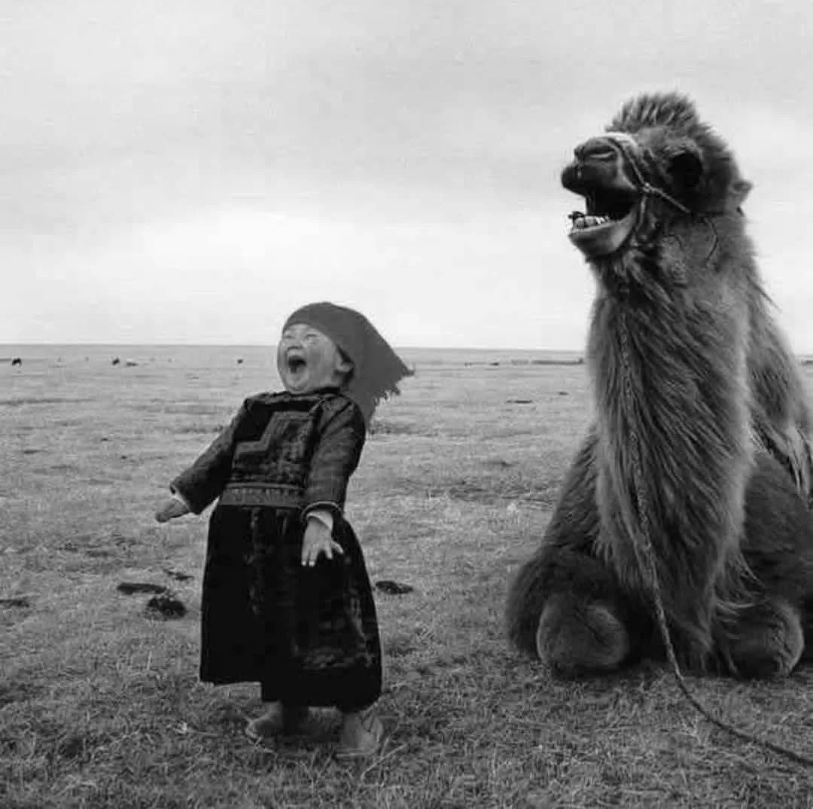
Neighborhood Specifics
Complete (deterministic)
Partial (probabilistic)
First improvement

Slide 13
Aspiration Criteria Specifics
Best so far
Best in neighborhood
Dissimilar to existing solution (diversification)
Similar to existing solution (intensification)
High influence – degree of change in structure or feasibility

Slide 14
More Complex Strategies
Strategic Oscillation
Generally moving between feasible and infeasible border
Path Relinking and Tunneling
Move step by step (by the shortest route) from one good solution to another good solution (tunneling allows stepping through infeasible solutions ). Restart at one of these interim solutions.
If the good solutions are similar, this is intensification
If the good solutions are dissimilar, this is diversification
Backtracking
Keep track of “elite” solutions and restart at them but move in a different direction
Restart
Like backtracking but start from purely random new solution
Theory of TS
None

Slide 15
Downsides of TS
Single solution search method
Tends to prematurely converge to local optimum – must counteract this by diversification, restart
Can be sensitive to starting solution
Can be sensitive to tabu list length and content (especially by content)
Is most effective where there is a good neighborhood structure than can be exploited through proper moves
Not very appropriate for continuous optimization

Slide 16
Some Websites
https://www.youtube.com/watch?v=bzEyAmL2JyY video from then Georgia Tech professor – Pascal Van Hentenryck – a well done ½ hour introduction to TS – the first few minutes are especially fun!
https://www.youtube.com/watch?v=-k859txmZgI long video (90 minutes) by Manual Laguna, a long-time collaborator of Fred Glover – detailed and well-done extensive introduction to TS
https://www.geeksforgeeks.org/what-is-tabu-search/ link with overview and code in 3 languages (Python, C++, C#)

